Slide 1
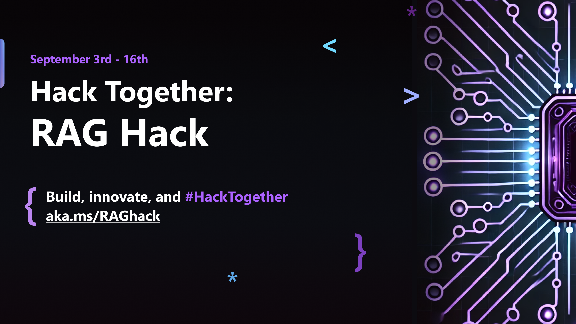

Slide 2
RAGHack streams
aka.ms/RAGhack
Week 1: September 3 - 8
9
MONDAY
3
TUESDAY
4
WEDNESDAY
5
THURSDAY
6
FRIDAY
7
SATURDAY
8
SUNDAY
RAG 101
.NET
Azure AI Studio
Python
Langchain4J
LangchainJS
Responsible AI
MongoDB
Azure AI Search
PostgreSQL
Azure SQL
GraphRAG
Multi-channels
Hack!
Hack!
Hack!
Hack!
Hack!
Hack!
Week 2: September 9 - 14
9
MONDAY
10
TUESDAY
11
WEDNESDAY
12
THURSDAY
13
FRIDAY
14
SATURDAY
15
SUNDAY
Semantic Kernel
Spring AI
Vision models
Internationalization
VSCode Agent
Agentic RAG
Code Interpreter
AI Studio Advanced
AutoGen
Data Access Control
Fine Tuning
Model catalog
Evaluations
Hack!
Hack!
Hack!
Hack!
Hack!
Hack!
Hack!
Hack!
Hack!
Submissions due September 16, 11:59 PM PT!

Slide 3
RAGHack streams in more languages!
Spanish:
aka.ms/RagHack2024Espanol
Portuguese:
aka.ms/S-1374
Chinese:
aka.ms/S-1380
RAG: Generación Aumentada de Recuperación
Prácticas recomendadas de Azure AI Search
AI Multi-Agentes: Patrones, Problemas y Soluciones
RAG (Geração Aumentada de Busca) no Azure
Construindo RAG com Azure AI Studio e Python
Implantando RAG com .NET e Azure Developer CLI
Global RAG Hack Together
Create RAG apps with Azure AI SDK
Create RAG applications with AI Toolkit VSCode Extension
Intro to GraphRAG

Slide 4
RAGHack prizes
Best overall
Best in JavaScript/TypeScript
Best in Java
Best in .NET
Best in Python
Best use of AI Studio
Best use of AI Search
Best use of PostgreSQL
Best use of Cosmos DB
Best use of Azure SQL
Each winning team will receive a cash prize of $500 💰

Slide 5
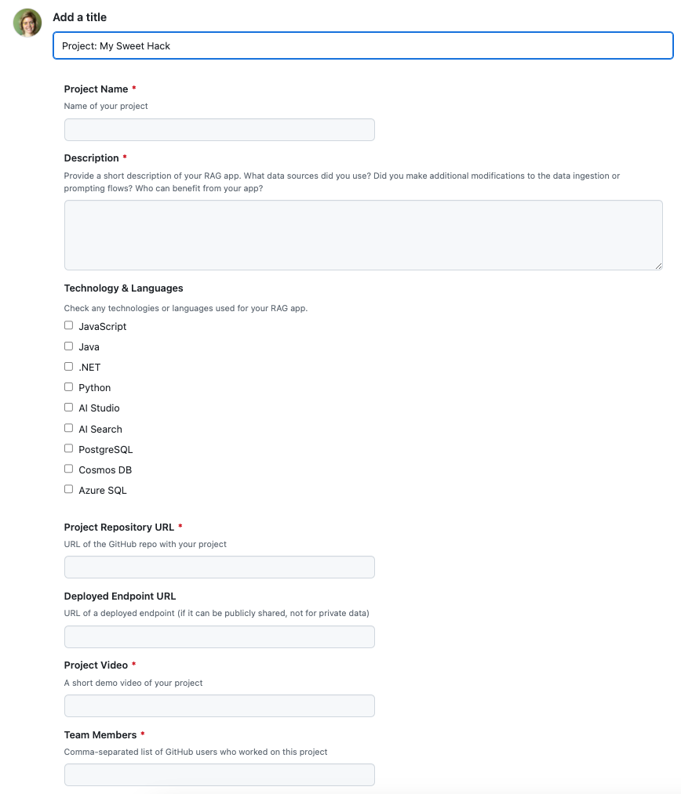
RAGHack submission process
Register by registering for any of the RAGHack live streams linked from aka.ms/raghack/streams
Before September 16, 11:59 PM PT, submit your hack by filing an issue in aka.ms/raghack and fill out all the fields. A project repo and demo video is required, a deployed endpoint is optional. Include team members if you have any.
Wait a few weeks for judges to score!

Slide 6
RAG: Retrieval Augmented Generation 101
Pamela Fox, Python Cloud Advocate
@pamelafox
pamelafox.org

Slide 7
LLMs: Large Language Models

Slide 8
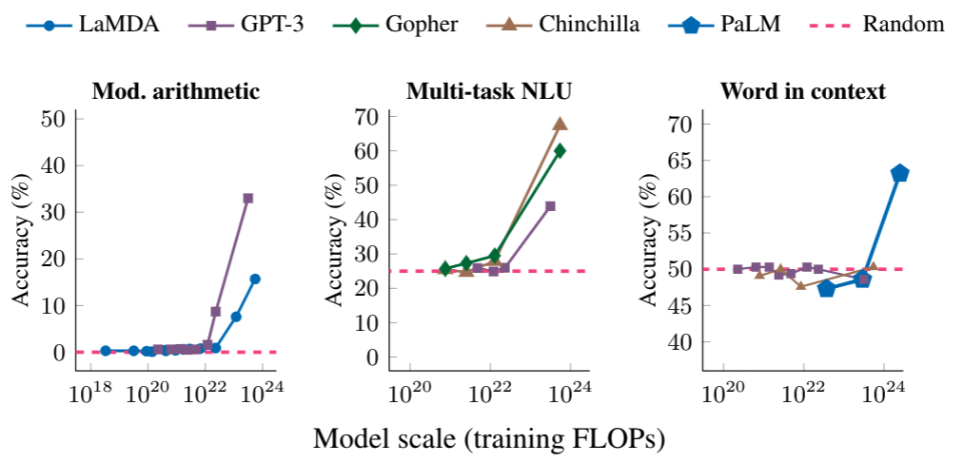
LLM: Large Language Model
An LLM is a model that is so large that it achieves general-purpose language understanding and generation.
Review: This movie sucks.
Sentiment: negative
Review: I love this movie:
Sentiment:
Input
LLM
Output
positive

Slide 9
Using LLMs on Azure
Creator | Models | How to use on Azure?
OpenAI | GPT3.5, GPT4, GPT4o, ada-002, text-embedding-3 | Azure OpenAI, GitHub Models
Microsoft | Phi-3, Phi-3mini | Azure AI Model Catalog, GitHub Models
Mistral | Nemo, Small, Large
Cohere | Command R, Command R+, Embed
Meta | LlaMA 3.1-8B, 70B, 405B
https://azure.microsoft.com/products/ai-services/openai-service
https://azure.microsoft.com/products/ai-model-catalog
https://github.com/marketplace/models

Slide 10
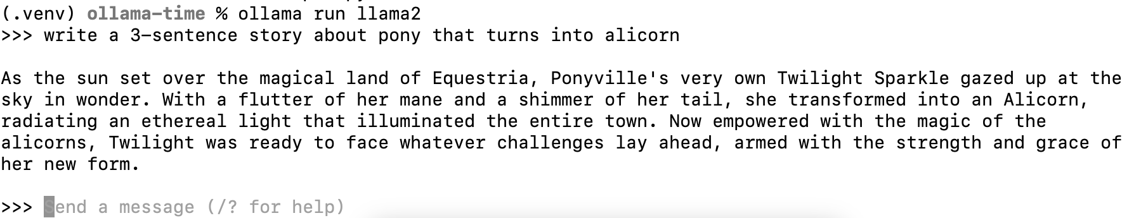
Using LLMs locally
Ollama is a tool for easily running local LLMs on your computer.
https://ollama.com/
You can also run it from GitHub Codespaces:
aka.ms/ollama-python: Ollama Python Playground

Slide 11
Using LLMs from Azure OpenAI
POST https://SERVICE_NAME.openai.azure.com/openai/deployments/
DEPLOYMENT_NAME/chat/completions?api-version=2024-02-15-preview
Authorization: Bearer AUTH_TOKEN
Content-Type: application/json
{
"messages":
[{"role":"system","content":"You are an AI assistant that loves emojis."},
{"role":"user","content":"What is the capital of France?"}],
"max_tokens": 800,
"temperature": 0.7,
"frequency_penalty": 0,
"presence_penalty": 0,
"top_p": 0.95,
"stop": null
}
https://github.com/pamelafox/python-openai-demos

Slide 12
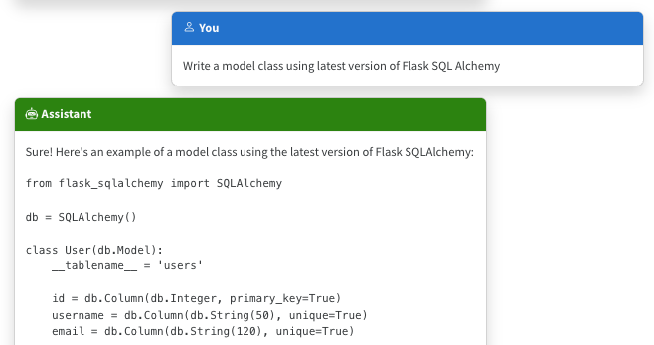
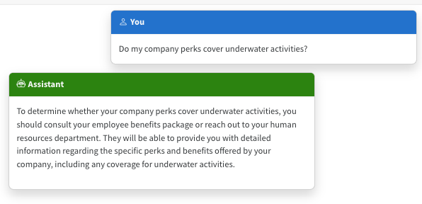
The limitations of LLMs
Outdated public knowledge
No internal knowledge

Slide 13
Integrating domain knowledge
Fine tuning
Retrieval Augmented
Generation
Learn new skills
(permanently)
Learn new facts
(temporarily)
💵 High cost, time 🕰️

Slide 14
Retrieval Augmented Generation

Slide 15




RAG: Retrieval Augmented Generation
The Prius V has an acceleration of 9.51 seconds from 0 to 60 mph.
How fast is the Prius V?
vehicle | year | msrp | acceleration |
--- | --- | --- | --- | --- | ---
Prius (1st Gen) | 1997 | 24509.74 | 7.46 |
Prius (2nd Gen) | 2000 | 26832.25 | 7.97 |
Prius (3rd Gen) | 2009 | 24641.18 | 9.6 |
Prius V | 2011 | 27272.28 | 9.51 |
Prius C | 2012 | 19006.62 | 9.35 |
Prius PHV | 2012 | 32095.61 | 8.82 |
Prius C | 2013 | 19080.0 | 8.7 |
Prius | 2013 | 24200.0 | 10.2 |
Prius Plug-in | 2013 | 32000.0 | 9.17 |
User
Question
Document Search
Large Language Model

Slide 16
RAG with Azure OpenAI
POST https://SERVICE_NAME.openai.azure.com/openai/deployments/
DEPLOYMENT_NAME/chat/completions?api-version=2024-02-15-preview
Authorization: Bearer {{$dotenv TOKEN}}
Content-Type: application/json
{"messages": [
{"role":"system", "content":"You are a helpful assistant that answers questions about cars based off a hybrid car data set. You must use the data set to answer the questions, you should not provide any info that is not in the provided sources. Sources are provided as a Markdown table."
},
{"role":"user", "content": "How fast is the Prius V?\n\nSources: vehicle | year | msrp | acceleration | mpg | class\n --- | --- | --- | --- | --- | --- |\nPrius (1st Gen) | 1997 | 24509.74 | 7.46 | 41.26 | Compact|\nPrius (2nd Gen) | 2000 | 26832.25 | 7.97...
}]}
https://github.com/pamelafox/python-openai-demos/blob/main/retrieval_augmented_generation.py

Slide 17
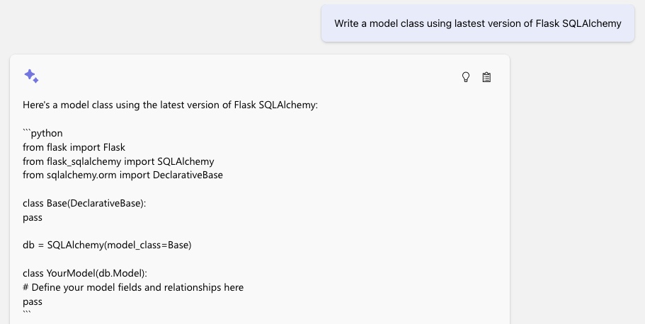
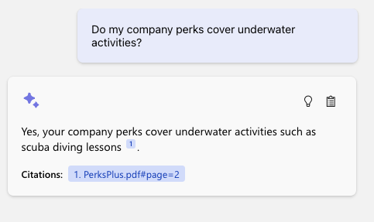
The benefits of RAG
Up-to-date public knowledge
Access to internal knowledge

Slide 18
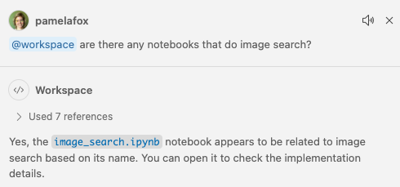
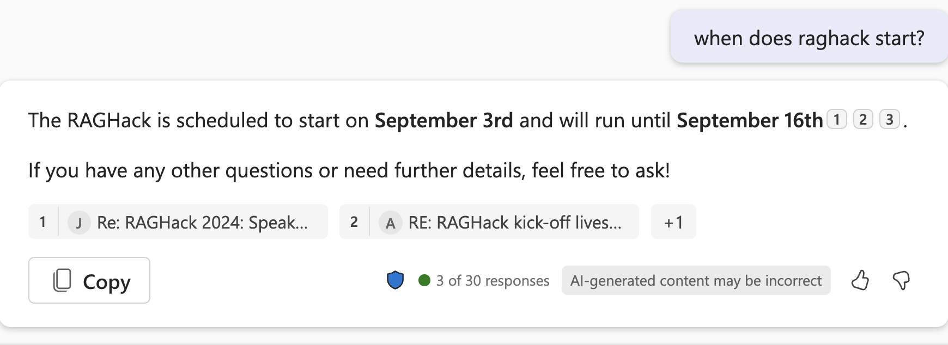
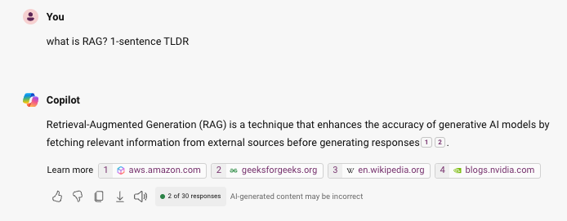
RAG in the wild
GitHub Copilot (RAG on your VSCode workspace)
Teams Copilot (RAG on your chats)
Bing Copilot
(RAG on the web)

Slide 19
Types of RAG

Slide 20
Types of RAG
RAG flows:
Simple RAG
Advanced RAG with Query rewriting
RAG sources:
Structured data (DB tables)
Documents (PDF, MD, etc.)
GraphRAG

Slide 21
Simple RAG
For great hiking shoes, consider the TrekExtreme Hiking Shoes ¹ or the Trailblaze Steel-Blue Hiking Shoes ²
What's the best shoe
for hiking?
[101]:
Name: TrekExtreme Hiking Shoes Price: 135.99
Brand: Raptor Elite
Type: Footwear
Description: The Trek Extreme hiking shoes by Raptor Elite are built to ensure any trail.
…
User
Question
Search
Large Language Model

Slide 22
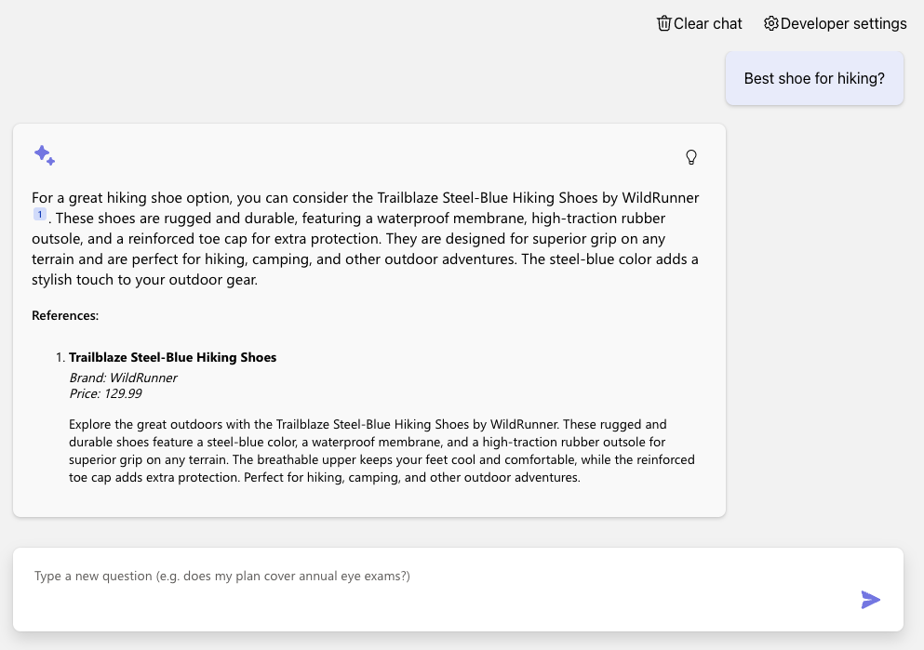
Simple RAG (on PostgreSQL)
Azure OpenAI +
Azure PostgreSQL Flexible Server +
Azure Container Apps
Code:
aka.ms/rag-postgres
Demo:
aka.ms/rag-postgres/demo

Slide 23
Advanced RAG with query re-writing
For great hiking shoes, consider the TrekExtreme Hiking Shoes ¹ or the Trailblaze Steel-Blue Hiking Shoes ²
what's a good shoe for a mountain trale?
mountain trail shoe
[101]:
Name: TrekExtreme Hiking Shoes Price: 135.99
Brand: Raptor Elite
Type: Footwear
Description: The Trek Extreme hiking shoes by Raptor Elite are built to ensure any trail.
…
User
Question
Large Language Model
Search
Large Language Model

Slide 24
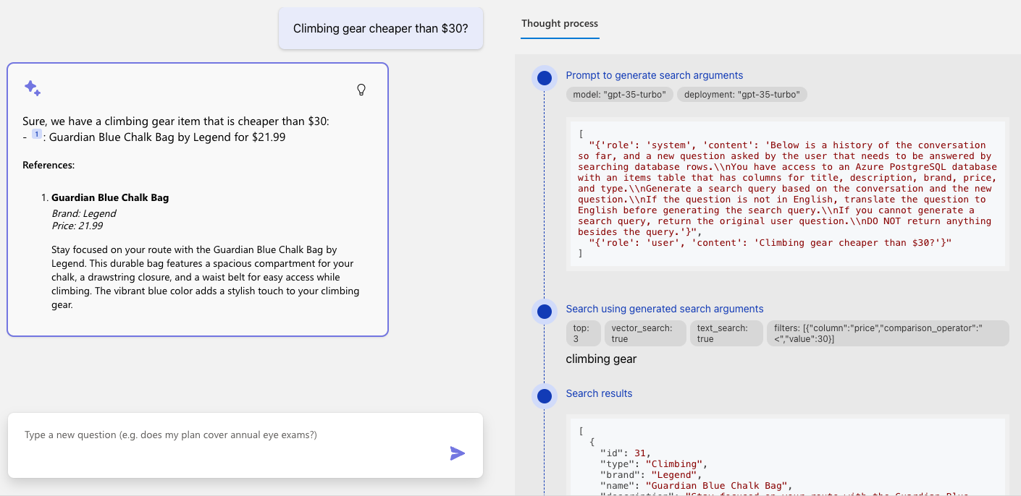
Advanced RAG (on PostgreSQL)

Slide 25
Query rewriting with function calling
Do you sell climbing gear cheaper than $30?
search_database(
"climbing_gear",
{"column": "price",
"operator" : "<",
"value" : "30"
}
)
Large Language Model with function calling
User
Question
Notes:
TODO: live-demo a brand filter

Slide 26
Advanced RAG with query rewriting via function calling
We offer 2 climbing bags for your budget:
SummitStone Chalk Bag ¹
Guardian Blue Chalk Bag ²
Do you sell climbing gear cheaper than $30?
“Do you sell…”
price < 30
“Do you sell…”
“climbing gear”
[12]:
Name: SummitStone Chalk Bag Price:29.99
Brand:Grolltex
Type:Climbing
Description: The SummitStone Chalk Bag in forest green is a must-have for climbers seeking adventure.
…
User
Question
LLM
with function calling
Search
LLM

Slide 27
RAG on documents
Yes, your company perks cover underwater activities such as scuba diving lessons ¹
Do my company perks cover underwater activities?
PerksPlus.pdf#page=2: Some of the lessons covered under PerksPlus include: · Skiing and snowboarding lessons · Scuba diving lessons · Surfing lessons · Horseback riding lessons These lessons provide employees with the opportunity to try new things, challenge themselves, and improve their physical skills.….
User
Question
Search
Large Language Model

Slide 28
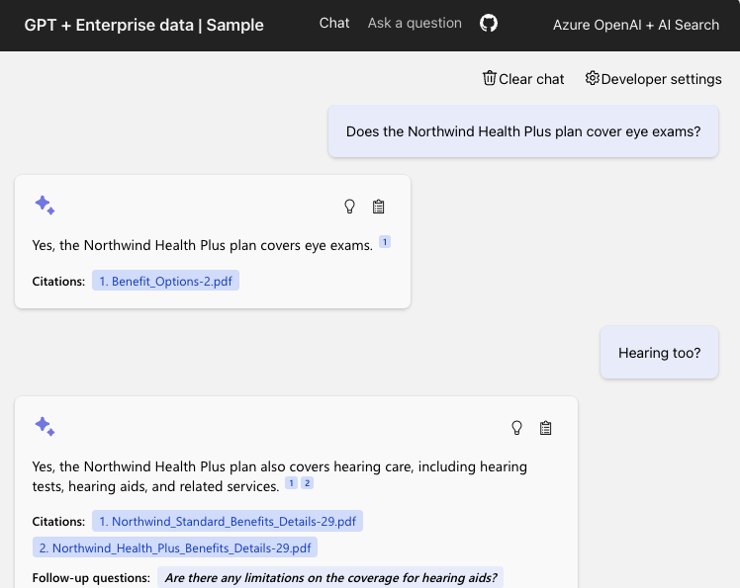
RAG on documents
Azure OpenAI +
Azure AI Search +
Azure App Service
Supports simple and advanced flows
(Ask tab vs. Chat tab)
Code:
aka.ms/ragchat
Demo:
aka.ms/ragchat/demo

Slide 29


RAG data sources
Database rows
(Structured data)
Documents
(Unstructured data)
PDFs, docx, pptx, md, html, images
You need a way to vectorize & search target columns.
PostgreSQL + pgvector
Azure SQL + vector search (upcoming)
Cosmos MongoDB + vector
You need an ingestion process
for extracting, splitting, vectorizing,
and storing document chunks.
Azure AI Search +
Integrated Vectorization
Document Intelligence or

Slide 30
Advanced RAG example: GitHub Copilot for Azure
Private Preview

Slide 31
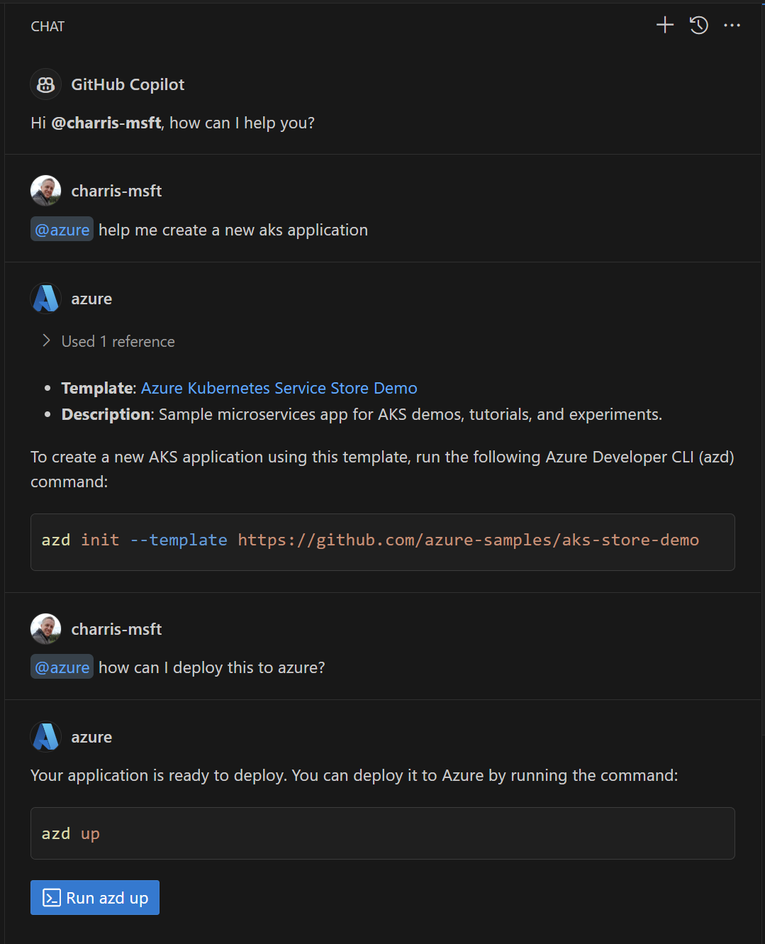
GitHub Copilot for Azure (@azure)
Helps developers in VS Code
learn about Azure services and how to use, deploy and manage them
find and deploy application templates quickly and easily to Azure
diagnose and troubleshoot application issues
work independently, minimizing reliance on senior team members and devops
https://aka.ms/GitHubCopilotForAzure

Slide 32
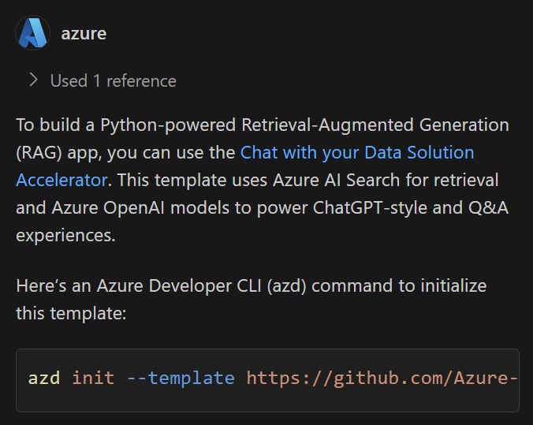


Architecture
@azure help me build a python-powered RAG app
User Prompt + Function definitions
1
"Call Template Recommender"
2
Template Recommender Service
Orchestrator
3
Large Language Model
[{"name": "Chat with...
"url": "https://github...
...
}]
Notes:
The Orchestrator first calls the LLM with the User Prompt and a list of functions that can be used to help. Then it calls the function recommended by the LLM, the Template Recommender Service.
Then it calls the LLM again with the User Prompt and the response from the Template Recommender to generate the response for the user.

Slide 33
Building a RAG app

Slide 34
RAG components
Component | Examples
Retriever: A knowledge base that can efficiently retrieve sources that match a user query (Ideally supports both vector and full-text search) | Azure AI Search, Azure CosmosDB, PostgreSQL, Qdrant, Pinecone
LLM: A model that can answer questions based on the query based on the provided sources, and can include citations | OpenAI: GPT 3.5, GPT 4, GPT-4o Azure AI Studio: Meta Llama3, Mistral, Cohere R+
Orchestrator (optional): A way to organize calls to the retriever and LLM | Community: Langchain, Llamaindex Microsoft: Semantic Kernel, Promptflow
Features | Chat history, Feedback buttons, Text-to-speech, User login, File upload, Access control, etc.

Slide 35
Many ways to build a RAG app
Copilot studio
Azure Studio On Your Data
Open source solutions
No Code
Low Code
High Code

Slide 36
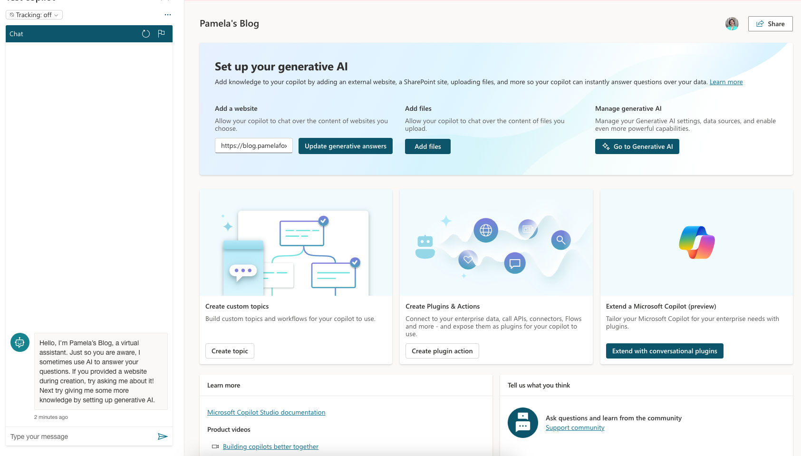
Copilot Studio
Retriever:
Uploaded files
LLM: GPT 3.5, GPT 4
https://copilotstudio.preview.microsoft.com/

Slide 37
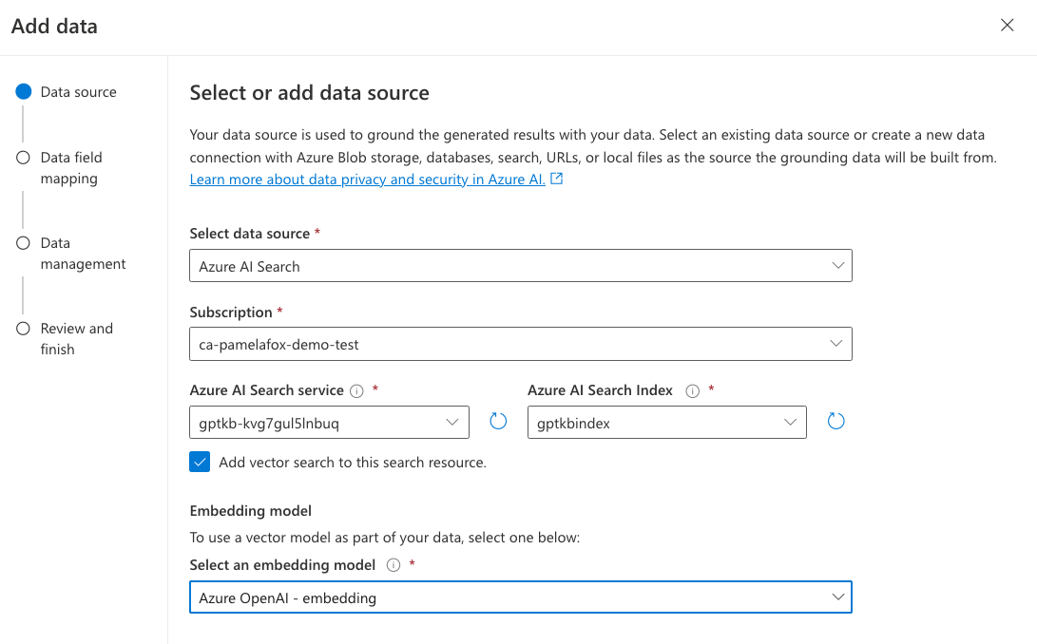
Azure OpenAI Studio – On Your Data
Retriever:
Azure AI Search
Azure Blob Storage
Azure CosmosDB for MongoDB vCore
URL/Web address
Uploaded files
LLM: GPT 3.5/4
Features:
User authentication
Chat history persistence
https://learn.microsoft.com/azure/ai-services/openai/concepts/use-your-data

Slide 38

Open-source RAG chat app: Python
Retriever:
Azure AI Search
LLM: GPT 3.5/4
Features:
Multi-turn chats
User authentication with ACLs
Chat with image documents
"Building RAG apps in Python"
September 3, 10:00 PM UTC / 03:00 PM PT
aka.ms/raghack/python
github.com/Azure-Samples/azure-search-openai-demo

Slide 39
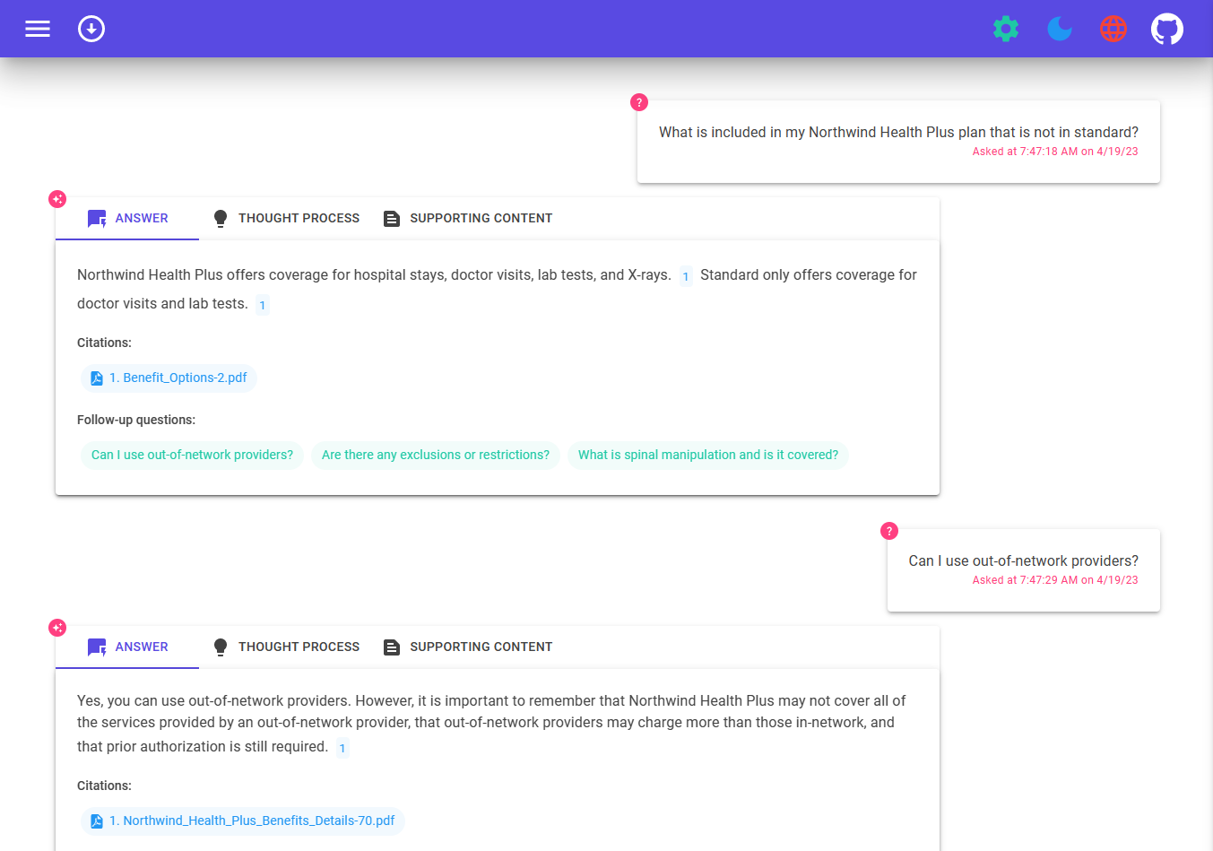
Open-source RAG chat app: .NET
Retriever: Azure AI Search
LLM: GPT 3.5/4
Orchestrator: Semantic Kernel
Features:
Voice chat
"Building RAG apps in .NET"
Sept. 3, 6:00 PM UTC / 11:30 AM PT
aka.ms/raghack/dotnet
github.com/Azure-Samples/azure-search-openai-demo-csharp

Slide 40
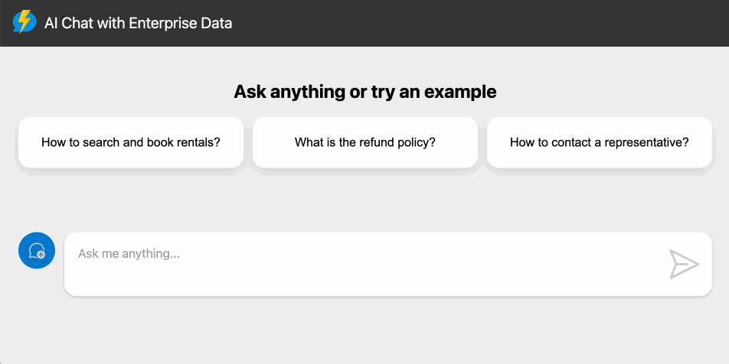
Open-source RAG chat app: JavaScript
Retriever: Cosmos DB for NoSQL
LLM: GPT 3.5/4
Orchestrator: Langchain.JS
Features:
Serverless architecture (Azure Functions)
"Building RAG apps in Langchain.JS"
September 4, 3:00 PM UTC / 8:00 AM PT
aka.ms/raghack/js
https://github.com/Azure-Samples/serverless-chat-langchainjs

Slide 41
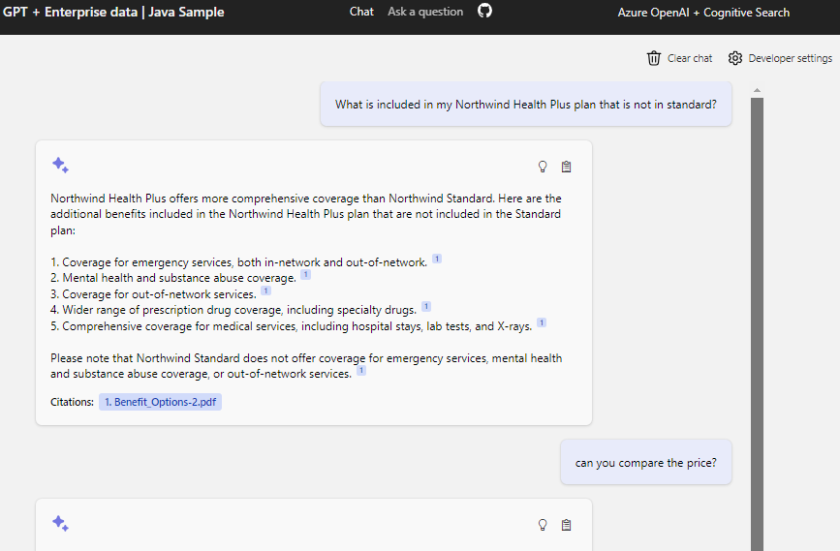
Open-source RAG chat app: Java
Retriever: Azure AI Search
LLM: GPT 3.5/4
Orchestrator: Semantic Kernel
"Building RAG apps with
Java + Semantic Kernel"
Sept. 9, 3:00 PM UTC / 8:00 AM PT
aka.ms/raghack/java-sk
https://github.com/Azure-Samples/azure-search-openai-demo-java/

Slide 42
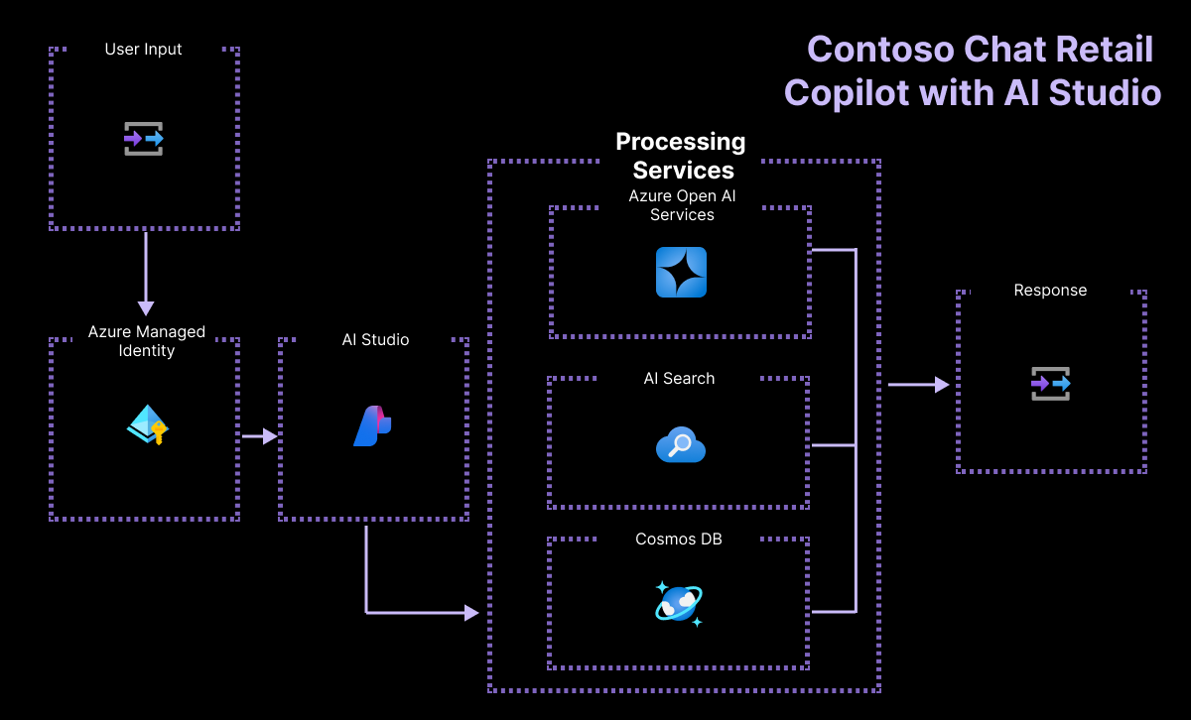
Open-source RAG chat solution: Azure AI Studio
Retriever: Azure AI Search
LLM: GPT 3.5/4
Orchestrator: PromptFlow
Features:
CosmosDB user info lookup
"Building RAG apps with
Azure AI Studio"
Sept. 3, 8:00 PM UTC / 1:00 PM PT
aka.ms/raghack/aistudio
https://github.com/Azure-Samples/contoso-chat

Slide 43
RAGHack: Next steps
aka.ms/raghack
Register for the hackathon @ aka.ms/raghack/register
Hack, hack, hack! Try our code samples or start from scratch!🧑🏿‍💻 👩🏻‍💻 👩🏼‍💻
For any questions, post in GitHub forum or attend Discord Office Hours. 🙋🏼 🙋🏾‍♀️
Join more live RAG sessions! aka.ms/raghack/streams
Submit your project before September 16th 11:59 PM PT to win prizes! 💵

